Slide 1
Nonlinear Pricing
Pricing Strategies
2025
Jean-Pierre Dubé
© Copyright 2025

Slide 2
Overview
Definition: Nonlinear Pricing refers to contexts in which there is a nonlinear relationship between the price charged and the quantity of goods sold.
Price discrimination between each unit sold to a customer
Managing a menu of non-linear pricing schedules boils down to product line pricing for segmentation
Use quantity as “fence” (instead of quality) to capture value
Definition: Nonlinear Pricing refers to pricing structures with a nonlinear relationship between the price charged and the quantity of goods/services sold.

Slide 3
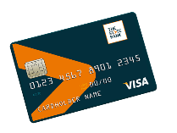
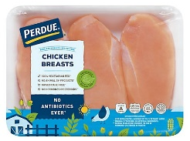
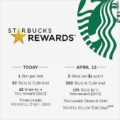

NL Pricing Examples
Credit Card Pricing
Monthly Fee & Interest Rate
Perdue Frozen Chicken
Regular Pack: $4.99/lb.
5 pound bag: $3.99/lb
Loyalty Program
lower price on consecutive units
Amazon’s Kindle Unlimited program
$9.99/month
Unlimited access to over 3 million eBooks
2-part tariff
Volume discount
(“Commodity Bundle”)
Quantity discount schedule
(“Incremental units pricing”)
subscription

Slide 4
NL Pricing as Segmentation
Look for variation in WTP for each incremental unit demanded
Two economic rationales for using non-linear pricing to segment:
Targeted Pricing with a single customer
Product Line Pricing with different customer segments
See Dolan (1987) for a more formal treatment of nonlinear pricing
1
2

Slide 5
Strategies to capture value Two Illustrative Examples
Single Customer
Illustrate 3 ways of capturing surplus
Two Customers: High Volume/Value vs. Low Volume/Value
Illustrate threat of “trading down”
1
2

Slide 6
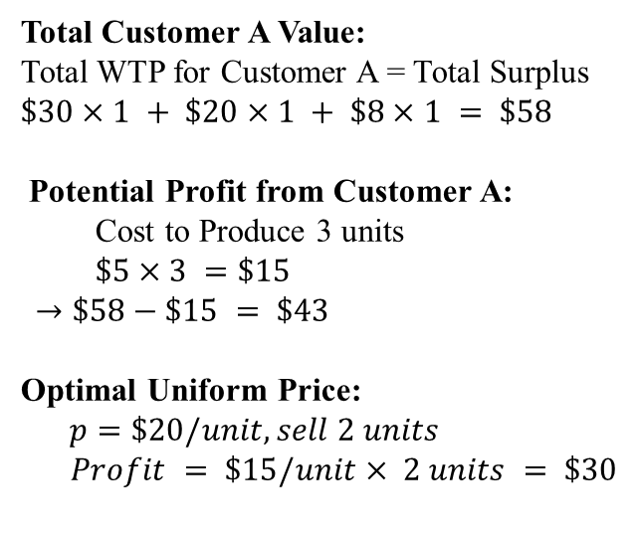
Example 1: Single Customer, potentially buys up to 3 units
Total Customer A Value:
Total WTP for Customer A = Total Surplus
$$\$30×1 + \$20×1 + \$8×1 = \$58$$
Potential Profit from Customer A:
Cost to Produce 3 units
$\$5×3 =\$15$
$$→\$58−\$15 = \$43$$
Optimal Uniform Price:
$p=\$20/unit, sell 2 units$
$Profit = \$15/unit× 2 units = \$30$
Customer A
WTP
for Units
$30
$20
$8
$5
MC
Money left on table
1 2 3 4 5 6
Units

Slide 7
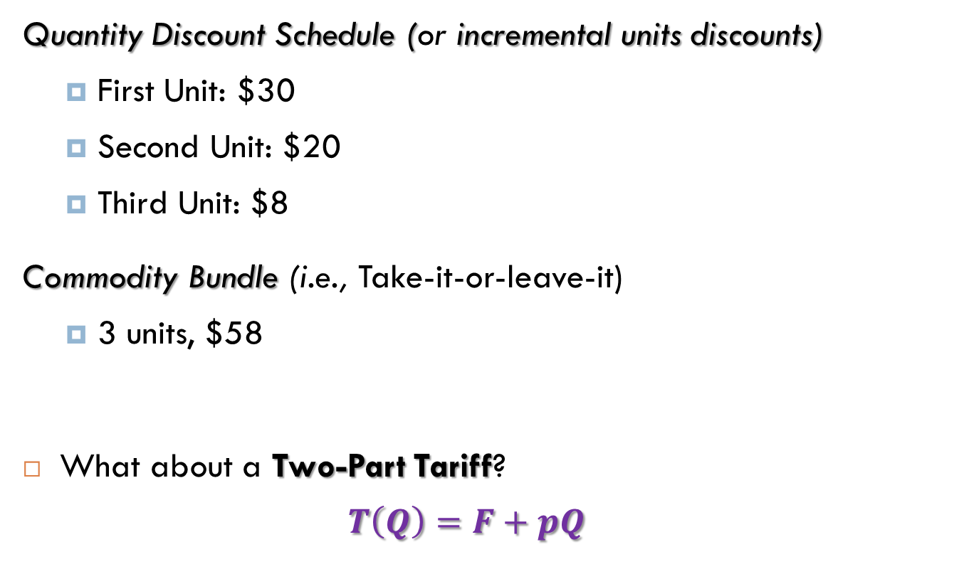
Example 1: Two Strategies to capture value
1
Quantity Discount Schedule (or incremental units discounts)
First Unit: $30
Second Unit: $20
Third Unit: $8
Commodity Bundle (i.e., Take-it-or-leave-it)
3 units, $58
What about a Two-Part Tariff?
$$T\left(Q\right)=F+pQ$$
2
Total charged
Fixed fee
Variable fee

Slide 8


Example 1: Two-Part Tariff
Access price
usage price
$$T\left(Q\right)=F+pQ$$
$=43+5Q$
Customer A
WTP
for Units
$30
$20
$8
$5
Customer’s surplus (CS) determines Fee, F, you can charge
So what’s best feasible variable price, p, to maximize CS?
And what fee does that let you charge?
MC
1 2 3 4 5 6
Units

Slide 9
Example 1: Three Strategies to capture value
1
Quantity Discount Schedule
1st Unit: p₁=$30
2nd Unit: p₂=$20
3rd Unit: p₃=$8
Commodity Bundle (i.e. Take-it-or-leave-it)
3 units, $58
Two-Part Tariff
p=$5 per unit (bill at marginal cost)
F = $25+$15+$3 = $43 entry fee (profit as up-front down-payment)
2
3

Slide 10
Challenges: Arbitrage Risks
Resale exclusion may be important to avoid competition from customers acting as secondary suppliers in resale markets
Bulk-buying and re-selling (grey markets)
Forward-buying
Perishability can limit such arbitrage
E.g., (digital) services industry can use non-linear pricing effectively because difficult/impossible to re-sell service
Appendix: Robinson-Patman Act and legality of B2B volume discounts in US retail channels

Slide 11
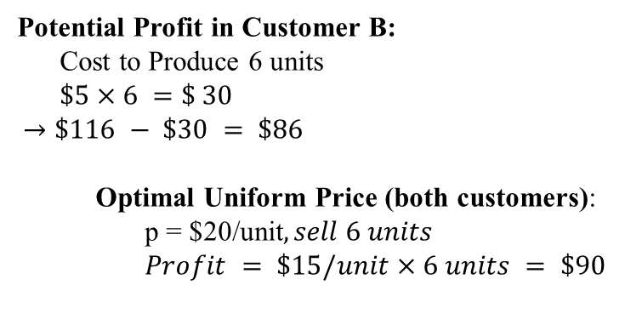
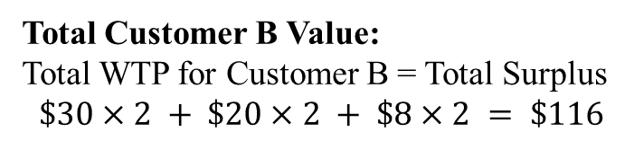
Example 2: Two customers, multiple units
Total Customer B Value:
Total WTP for Customer B = Total Surplus
$$\$30×2 + \$20×2 + \$8×2 = \$116$$
Customer A
Potential Profit in Customer B:
Cost to Produce 6 units
$\$5×6 =\$ 30$
$$→\$116 − \$30 = \$86$$
Optimal Uniform Price (both customers):
p = $20/unit$, sell 6 units$
$Profit = \$15/unit×6 units = \$90$
$30
$20
$8
$5
Customer B
WTP for Units
MC
1 2 3 4 5 6
Units

Slide 12
Example 2: Profits from both customers
TOTAL Potential Profit:
$43 + $86 = $129
(A) (B)
Uniform (linear) price: p = $20
sell 6 units (2 to A, 4 to B)
earn $90 in profit
leave ($129-$90) $39 potential profit on table!

Slide 13
Example 2: Look at Total WTP for n units
Customer A |  |  |  | Customer B
Units | WTP for n^{th} unit | Cumulative WTP |  | Units | WTP for n^{th} unit | Cumulative WTP
1 | 30 | 30 |  | 1 | 30 | 30
2 | 20 | 50 |  | 2 | 30 | 60
3 | 8 | 58 |  | 3 | 20 | 80
 |  |  |  | 4 | 20 | 100
 |  |  |  | 5 | 8 | 108
 |  |  |  | 6 | 8 | 116

Slide 14
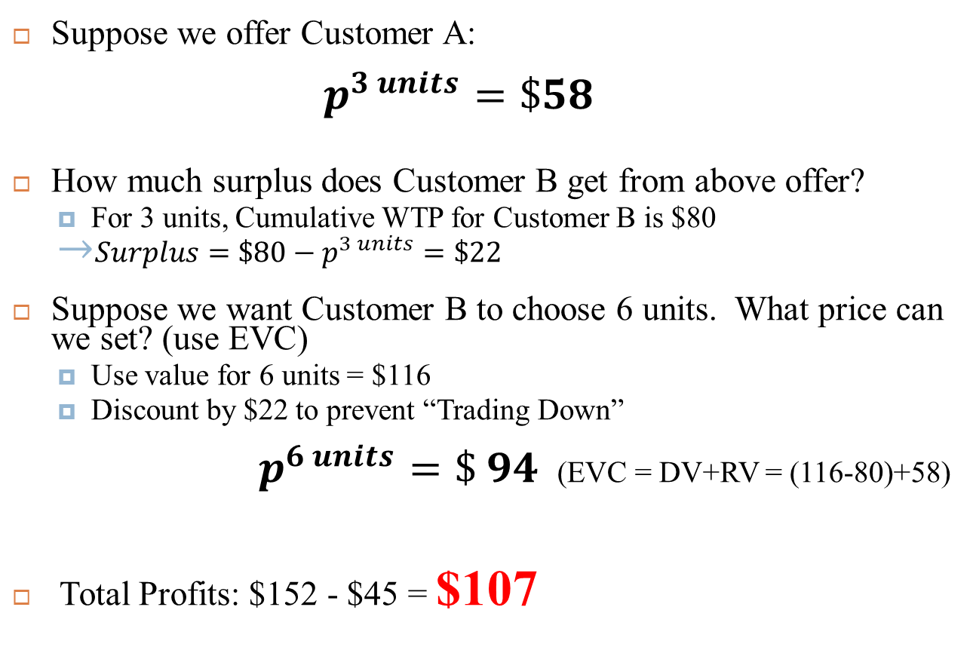
Example 2: Strategy 1
Suppose we offer Customer A:
$$p^{3 units}=\$58$$
How much surplus does Customer B get from above offer?
For 3 units, Cumulative WTP for Customer B is $80
${Surplus=\$80−p}^{3 units}=\$22$
Suppose we want Customer B to choose 6 units. What price can we set? (use EVC)
Use value for 6 units = $116
Discount by $22 to prevent “Trading Down”
$p^{6 units}=\$ 94$ (EVC = DV+RV = (116-80)+58)
Total Profits: $152 - $45 = $107

Slide 15
Example 2: Can we do better?
How did we manage trading-down in strategy 1?
Is this the only lever to manage customers’ incentives?
How else can we manage customers’ incentives?
Customer A |  |  |  | Customer B
Units | WTP for n^{th} unit | Cumulative WTP |  | Units | WTP for n^{th} unit | Cumulative WTP
1 | 30 | 30 |  | 1 | 30 | 30
2 | 20 | 50 |  | 2 | 30 | 60
3 | 8 | 58 |  | 3 | 20 | 80
 |  |  |  | 4 | 20 | 100
 |  |  |  | 5 | 8 | 108
 |  |  |  | 6 | 8 | 116

Slide 16
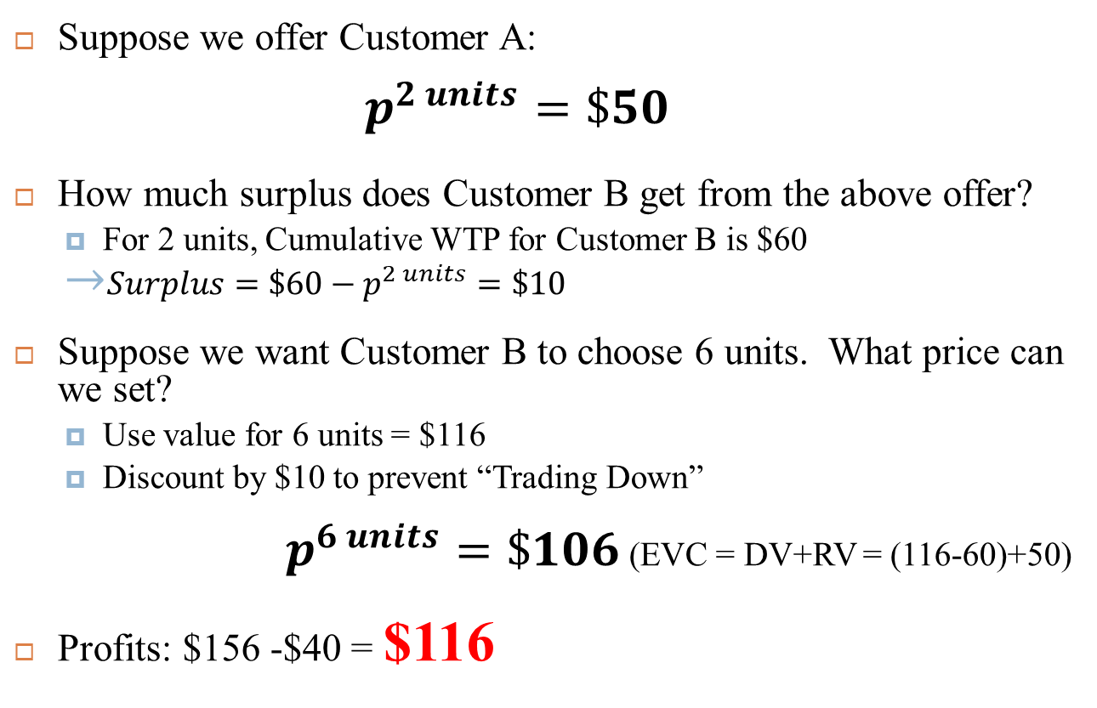
Example 2: Strategy 2
Suppose we offer Customer A:
$$p^{2 units}=\$50$$
How much surplus does Customer B get from the above offer?
For 2 units, Cumulative WTP for Customer B is $60
${Surplus=\$60−p}^{2 units}=\$10$
Suppose we want Customer B to choose 6 units. What price can we set?
Use value for 6 units = $116
Discount by $10 to prevent “Trading Down”
$p^{6 units}=\$106$ (EVC = DV+RV = (116-60)+50)
Profits: $156 -$40 = $116

Slide 17
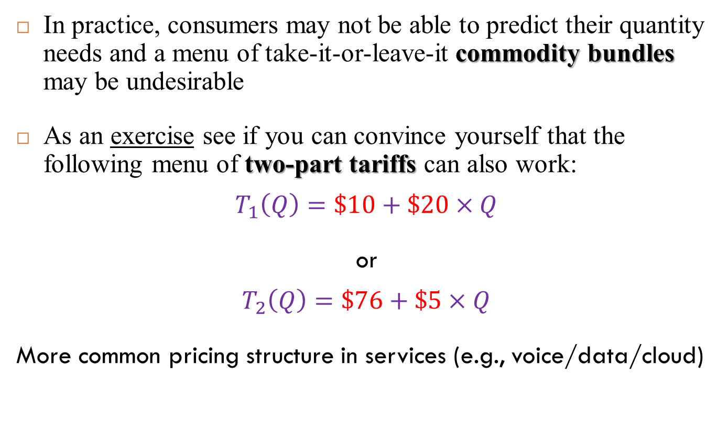
Example 2: Strategy 2 (b)
In practice, consumers may not be able to predict their quantity needs and a menu of take-it-or-leave-it commodity bundles may be undesirable
As an exercise see if you can convince yourself that the following menu of two-part tariffs can also work:
$$T_{1}\left(Q\right)=\$10+\$20×Q$$
or
$$T_{2}\left(Q\right)=\$76+\$5×Q$$
More common pricing structure in services (e.g., voice/data/cloud)

Slide 18
Two uses of NL pricing to capture value
Our examples illustrated:
With 1 customer, non-linear pricing “discriminates” across each unit sold
With multiple customers, a menu of non-linear prices “discriminates” between customers (segmentation)
Note: multiple non-linear pricing structures with same profit
1
2

Slide 19
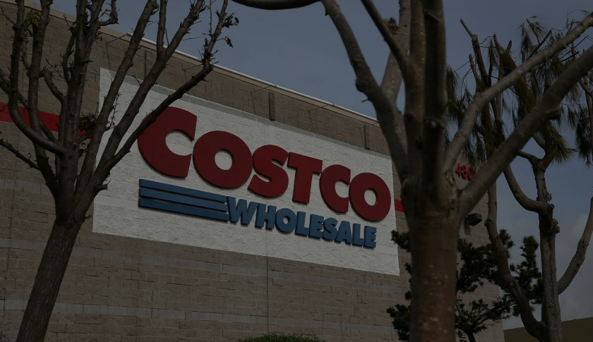
Menus of non-linear pricing in practice Example: Costco
Costco offers a menu of 2-part tariff style memberships
Executive Membership: $110/yr + 2% Reward
Gold Star Membership: $55/yr
“When others were raising their chicken prices from $4.99 to $5.99, we were willing to eat, if you will, $30 to $40 million a year in gross margin by keeping it at $4.99”
Richard Galanti, CFO, Costco
Sold 137 million chickens in 2023
Subscriber fees: 73% of 2024 gross profit ($4.8 Billion!)
Membership: 137 million worldwide (2024)
Retention rate: 93% (2024)
“Retailer” versus “Club”?
Notes:
http://www.fool.com/investing/general/2015/06/10/why-membership-fees-are-so-important-to-costco-who.aspx
https://consumerist.com/2015/05/29/costco-misses-out-on-40myear-because-of-5-rotisserie-chickens-and-its-okay-with-that/

Slide 20
Menus of non-linear pricing in practice Example: Costco
How Costco sustains $4.99 price in 2022, under inflation?
(i.e., no cost pass-through yet)
Most retailers now charger $6-$10
Vertical integration:
Raises several ethical concerns on humane sourcing of food
See appendix on Costco’s low inflation cost pass-through
“Costco’s inflation-proof $4.99 rotisserie chicken, explained
Vox, July 18, 2022
Notes:
http://www.fool.com/investing/general/2015/06/10/why-membership-fees-are-so-important-to-costco-who.aspx
https://consumerist.com/2015/05/29/costco-misses-out-on-40myear-because-of-5-rotisserie-chickens-and-its-okay-with-that/

Slide 21
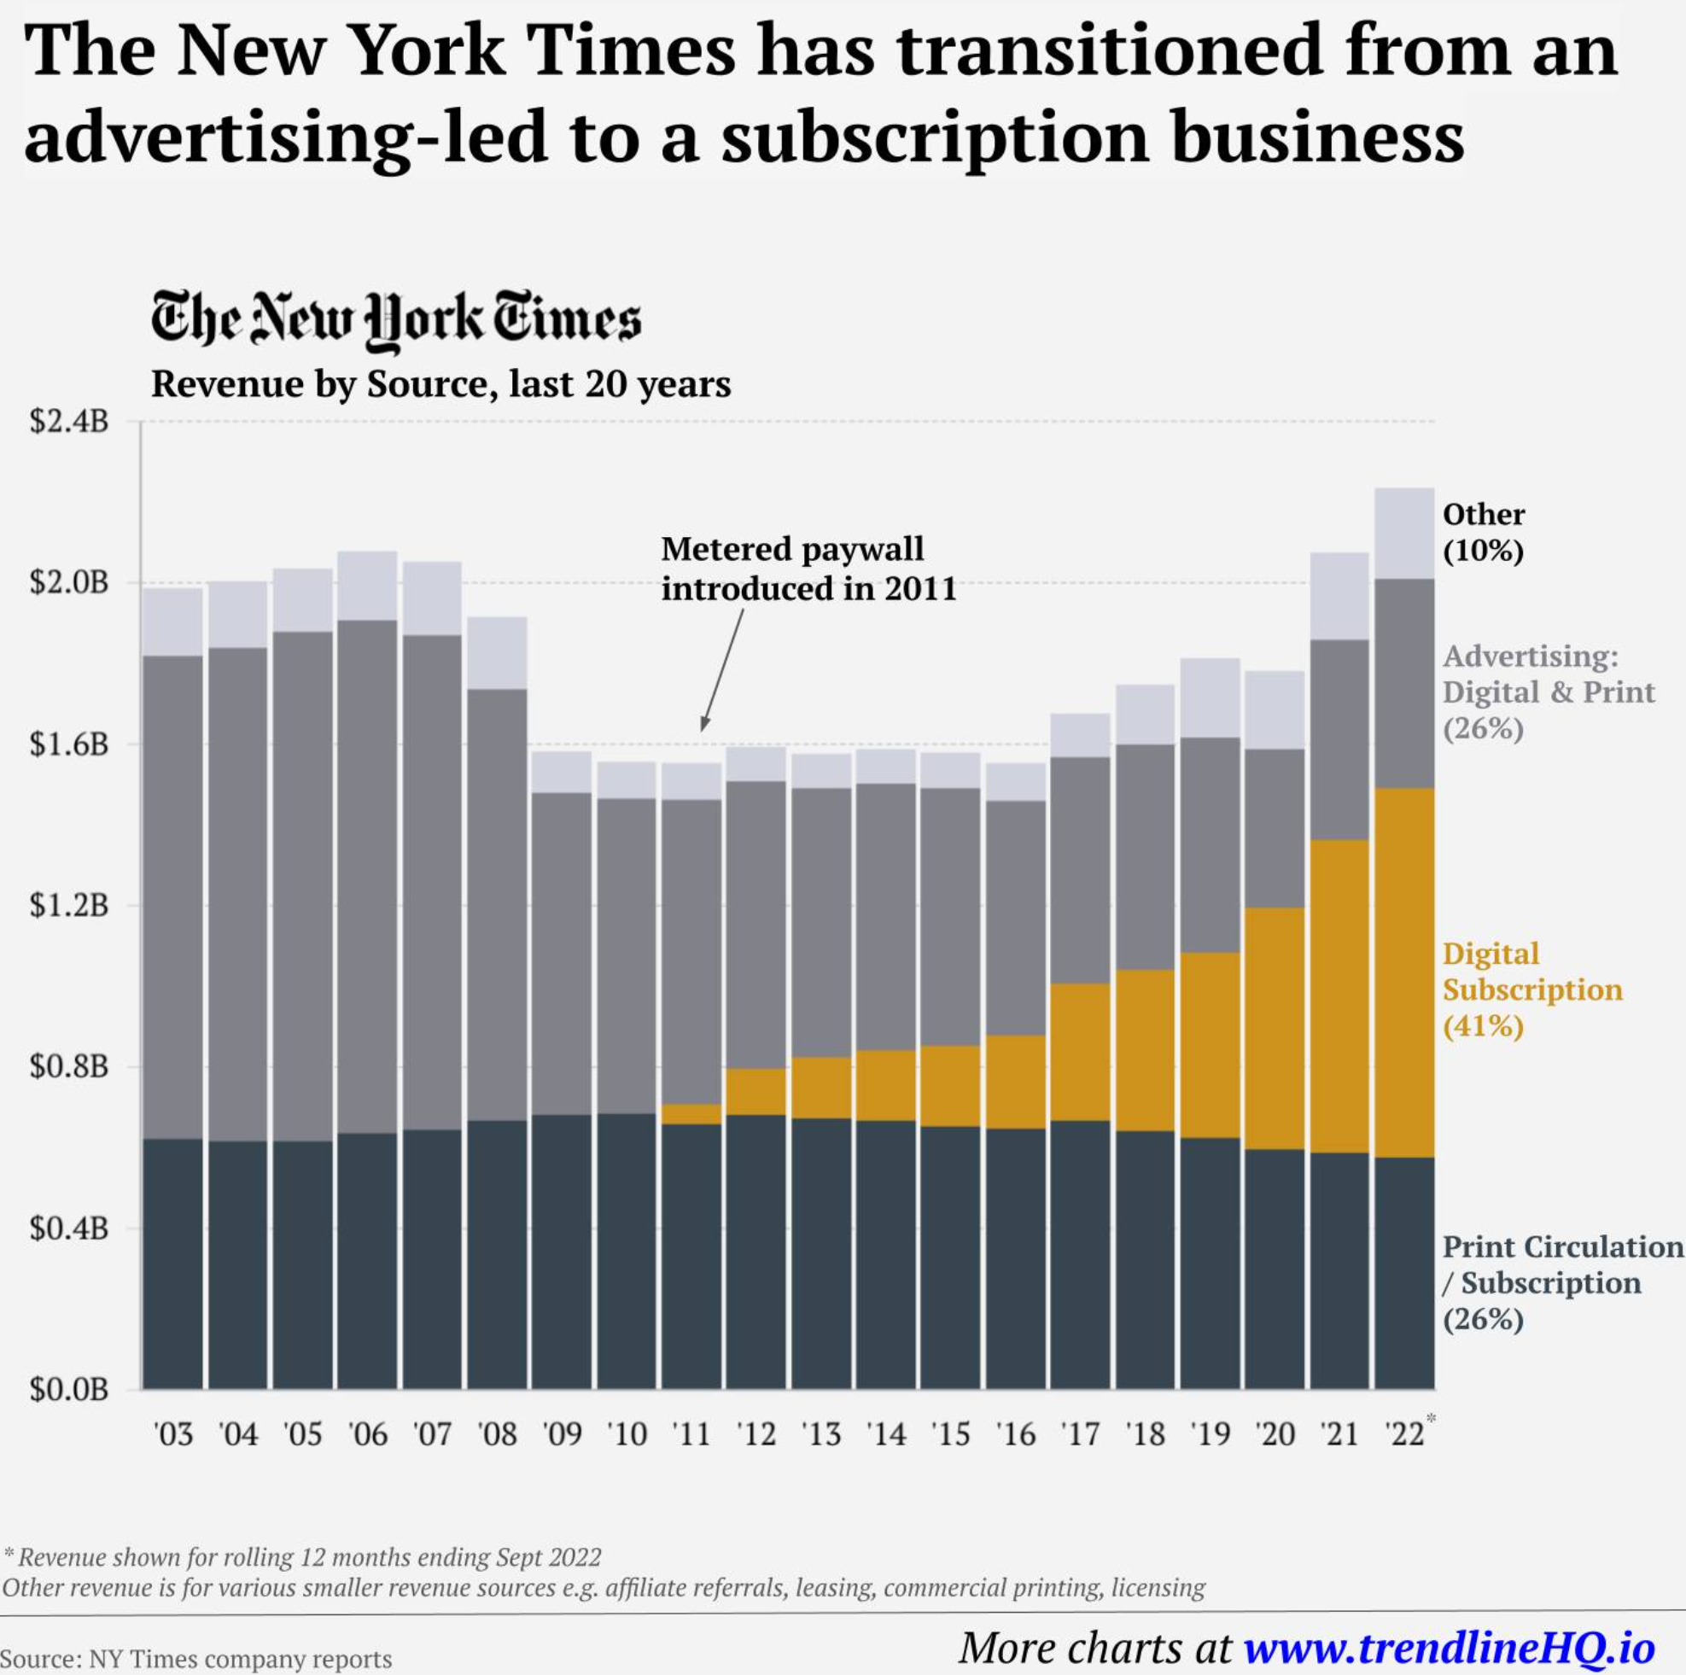
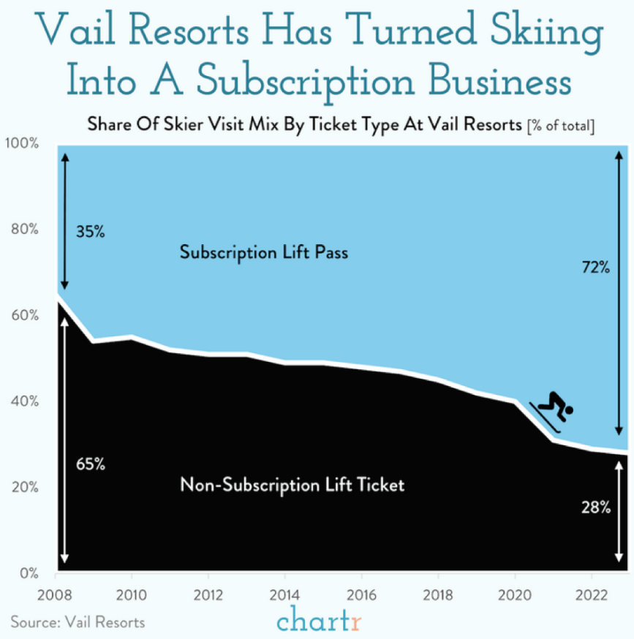
Two-Part Tariff with information goods Subscriptions
11 July 2025; Increasingly, many digital business moved towards subscription
If marginal cost = $0, a two-part tariff is a subscription!

Slide 22
But why the proliferation of subscriptions
Everything’s becoming a subscription, and the pandemic is partly to blame
Delivery services, socks, razors, gyms, streaming services, and even restaurants and car washes. Some Americans are now signed up for 10 or more. It’s bringing convenience — and a lot of monthly fees.
By Heather Long & Andrew Van Dam, Washington Post, June 1, 2021
“The UBS financial services firm predicts that this ‘subscription economy’ will grow to $1.5 trillion by 2025, more than double the $650 billion it’s estimated to be worth now.”

Slide 23

Flat-Rate Bias and Consumer Psychology
“New Year’s Resolutions. I WILL [...] go to the gym three times a week not merely to buy sandwich.”
- Bridget Jones’s Diary: A Novel
“Monday 28 April. [...] no. of gym visits so far this year 1, cost of gym membership per year £370.”
- Bridget Jones: The Edge of Reason
All-you-can-eat
vs
Pay-as-you-go
A study of 7,500 gym members showed
majority chose monthly fee instead of per-visit
over-paid by over 70%
Source: DellaVigna and Malmendier (2006)

Slide 24


Flat-Rate Bias & Consumer Psychology
flat rate bias – customers have a preference for a subscription (i.e., all-you-can-eat).
i.e., prefer to pay flat fee that costs more than metered service
Motivational Reasons
Pre-commitment
Risk aversion
Cognitive Reasons
Framing problem
Difficulty estimating probabilities
Usage uncertainty/inattention

Slide 25
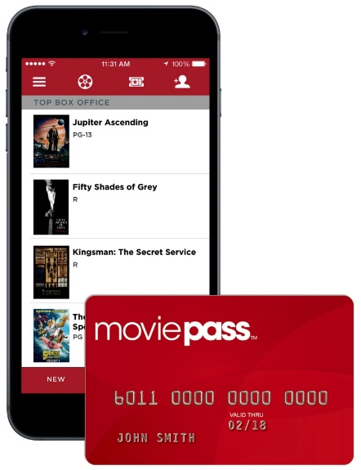
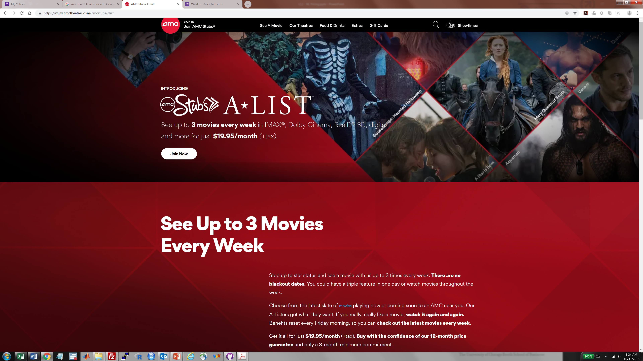
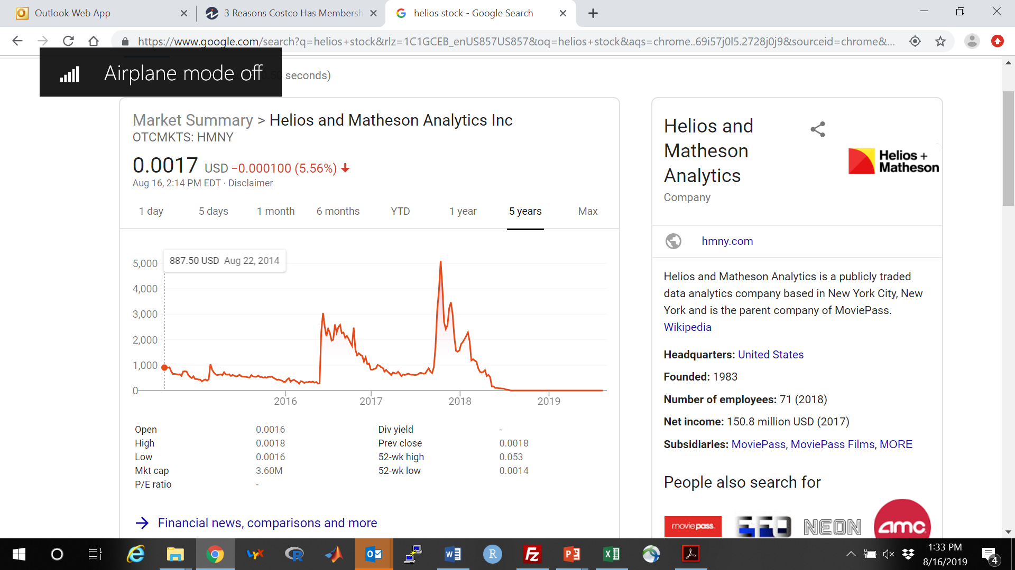

Flat-Rate Bias as double-edged sword MoviePass
$19.95/month (6/2018)
Commodity bundle: 3 per week
800,000 subscribers by 5-2019
#1 service in US in 2019
$9.95/month unlimited movies (8/2017)
2 million subscribers by 1/2018
“MoviePass Is Coming Back This Summer—But Will Things Be Different This Time Around?”
Marisa Dellatto, Forbes, 2-10-2022
Credit system using blockchain

Slide 26
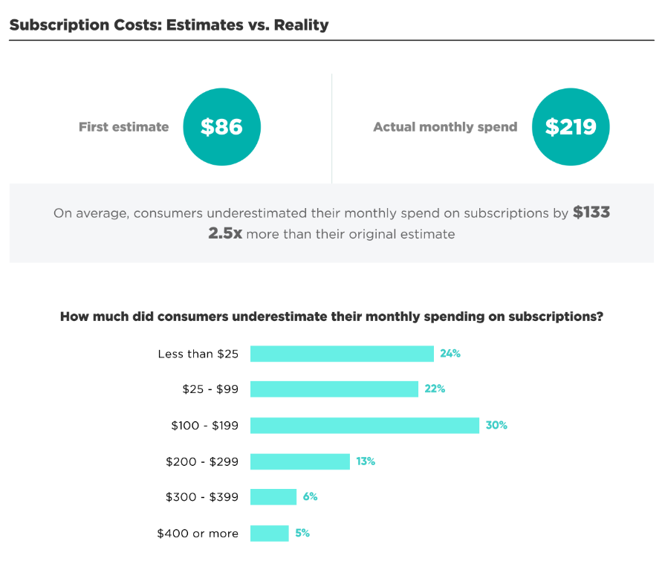
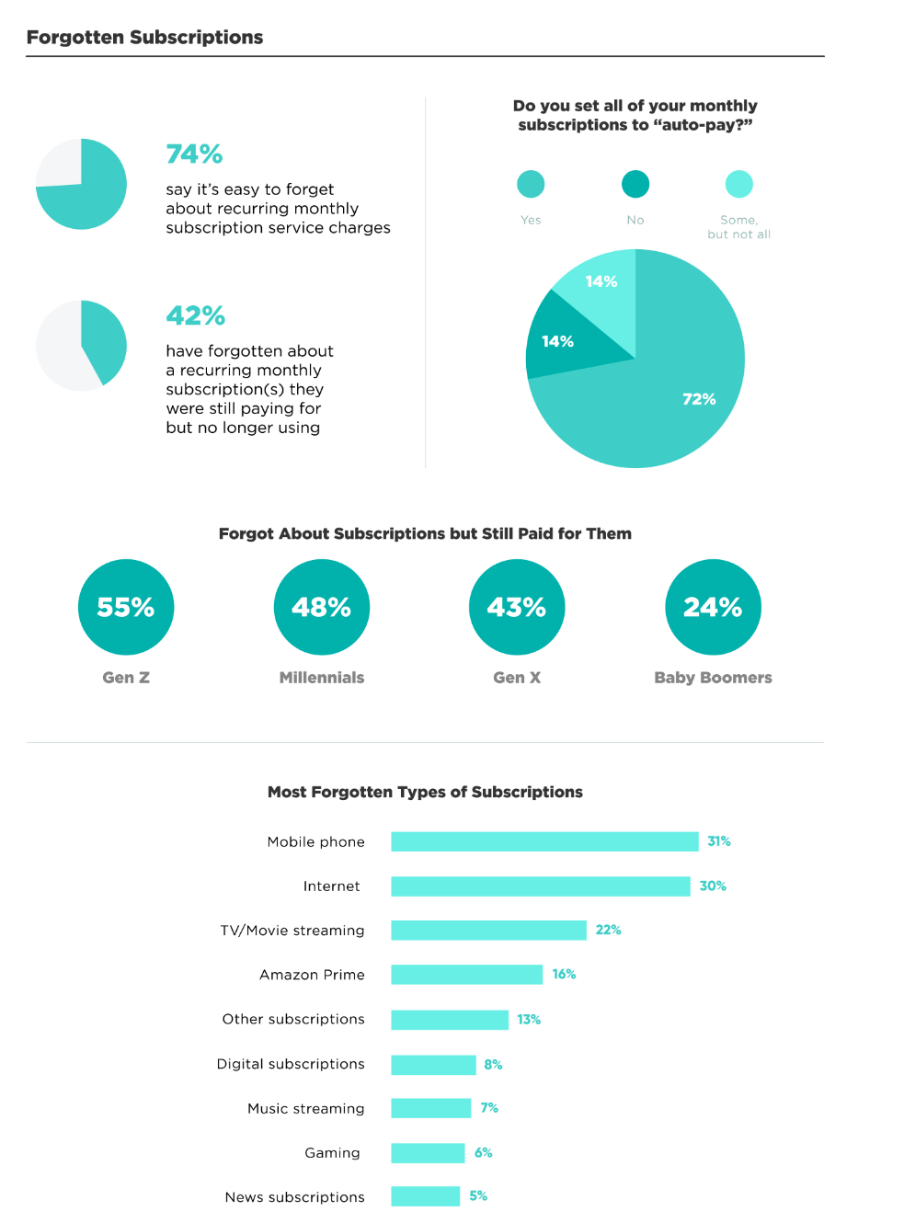
Marketing for Good? Subscriptions & consumer inattention
Over 50% under-estimate by at least $100!!!
Source: C+R Research

Slide 27
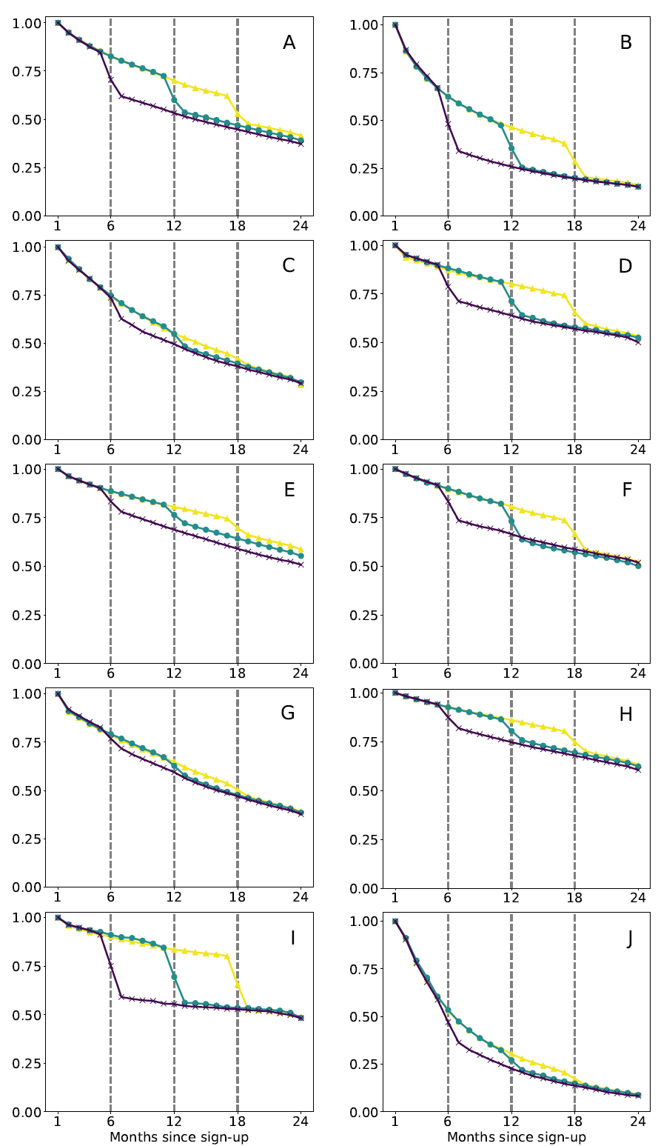
Marketing for Good? Subscriptions & consumer inattention
Use credit card expiration as “test” for inattention
12 subscription services
Millions of customers through a major credit card
Take millions subscribers with a card and who all signed up during same month
Compare retention rates when card expiration
6 months after
12 months after
18 months after
Inattention?????
Source: Einav et al (2025)

Slide 28
Marketing for Good? Subscriptions & consumer inattention
Auto-pay creates psychological switching costs…
until it doesn’t any more …
Consumer solutions:
“Subscription Price Creep Is Real. Our Guide to Pushing Back.”
Track down hidden recurring costs, binge strategically and consider free alternatives
Nicole Nguyen, WSJ, April 23, 2023
Regulatory solutions:
Federal Trade Commission Announces Final “Click to Cancel” Rule Making It Easier for Consumers to End Recurring Subscriptions and Memberships
FTC, Oct 16, 2024

Slide 29
Take Away
NL pricing as price discrimination:
For a single customer, NL pricing captures value
For multiple customer segments, menu of NL pricing offers as product-line pricing
Consumer psychology as implementation guide for NL pricing
Marketing for good:
Economic logic for NL pricing
vs
Exploitation of inattention using complex pricing structure
See Appendix for agency issues with NL pricing in financial services

Slide 30
NL Pricing of Financial Services

Slide 31
NL Pricing in Financial Services Example: fee-only versus fee-based
Traditional brokerage uses 2-part tariffs (fee+commission)
Recent surge in demand for fee-only service (all-you-can-eat).
Caution:
Deception of “fee-based” pricing typically just 2-part tariff
NL pricing affects the incentives of your asset manager!
Commissions incent more transactions
Fees tied to principal weaken incentives (i.e. less effort)
Fees tied to returns incents risk-taking
NL pricing special in this industry because you also need to understand the incentives induced by the pricing of your service for your advisor
Sources:
“Much Ado About Adviser Compensation,” Daisy Maxey, WSJ, Nov 10, 2013.
“How to Pay Your Financial Advisor,” Daisy Maxey, WSJ, Dec 12, 2011
Notes:
i.e. you may still need to pay a brokerage for the trades

Slide 32
Legality of NL Pricing in US

Slide 33
Non-Linear Pricing and B2B Laws The Robinson-Patman Act in the U.S.
Act requires Mfrs to sell products to all retailers at the same price – unless there is something significantly different (e.g. large-size packaging at Costco)
e.g. 32-packs of Coke, 3-packs of printer cartridges
Historically - protect small independent retailers (FTC vs Morton Salt Co.)
FTC now worried act shields less efficient competition
Why it's all in the packaging: 1936 antitrust ruling comes under fresh criticism
John Schmeltzer. Knight Ridder Tribune Business News. Jun 7, 2007.
Third Circuit Reverses Price Discrimination Judgment in Feesers v. Michael Foods and Sodexho . 08-January-2010
If abolished, big-box chains will surely command better volume discounts
Notes:
- Morton Salt: illegal for one firm to benefit over another due to buying power (i.e. access to volume discount)
- Feesers sued Michael Foods for selling liquid eggs and potato products cheaper to Sodhexo. Reversal b/c catering and food services (Feesers) not in direct competition with food distribution (Sodexho)

Slide 34
Non-Linear Pricing and B2B Laws The Robinson-Patman Act in the U.S.
Precedent may change under Lina Khan’s oversight of FTC
Pepsi, Coke soda pricing targeted in new federal probe
By Josh Sisco, Politico, Jan. 9, 2023
“Beverage giants Coca-Cola and PepsiCo are under preliminary investigation at the Federal Trade Commission over potential price discrimination in the soft drink market as the agency looks to revive a decades-old, but largely dormant law banning the practice, according to four people with knowledge of the probe. …For at least the last month the FTC has reached out to large retailers, including Walmart, seeking data and other information on how they purchase and price soft drinks, two of the people said. Walmart is not currently a target in the investigation, one of the people said.”
Notes:
- Morton Salt: illegal for one firm to benefit over another due to buying power (i.e. access to volume discount)
- Feesers sued Michael Foods for selling liquid eggs and potato products cheaper to Sodhexo. Reversal b/c catering and food services (Feesers) not in direct competition with food distribution (Sodexho)

Slide 35
Inflation and Cost Pass-Through on Costco Chicken

Slide 36
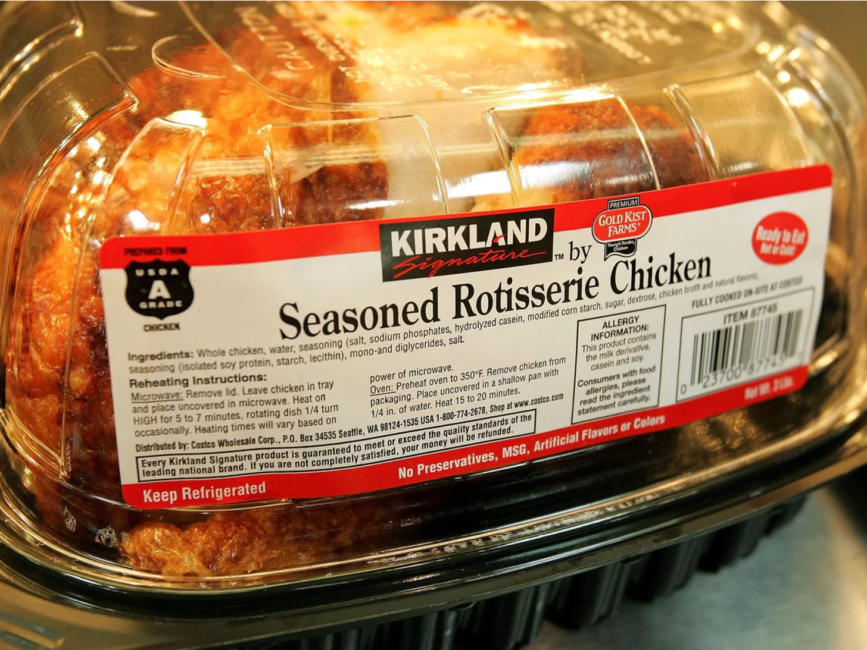
Retail Loss-Leader Pricing
Inflation is raising prices on almost everything, except rotisserie chicken
By Rachel Treisman, NPR, June 7 2022
Chicken prices up 16.4% in 2022, & predicted to increase 15-18%.
But BJ’s, Costco and Sam’s still charge under $5
Chains like Publix and Giant Eagle charge $7
“Rotisserie chickens in particular are a marketable combination of visible and Affordable…They're giving a cheapness aura to the store, which is helpful for consumers when they're concerned about their spending power.

Slide 37
Flat-Rate Bias
Mobile Voice and Data Services

Slide 38
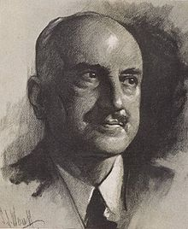
Perils of Flat-Rate Pricing Unlimited (all-you-can-eat) Data Plans
Those who cannot remember the past are condemned to repeat it.
George Santayana
Why every US carrier has a new unlimited plan
by Chaim Gartenberg@cgartenberg, The Verge, 2-17-2017
T-mobile eliminated tiered data pricing (Jan 2017)
Verizon announced unlimited plan (Feb 2017)
Sprint and AT&T responded with their own unlimited plans
Verizon famously eliminated all-you-can-eat data in 2011!
Competitive pricing pressure (prisoner’s dilemma ?)

